Slide 1

CORS
Cross Origin Resource Sharing
Aruna S
Department of
Computer Science and Engineering

Slide 2

CORS
Cross Origin Resource Sharing
S. Aruna
Department of Computer Science and Engineering

Slide 3
CORS
What are CORS?
CORS is a set of web standards developed to enable safe cross-domain communication.
Resources like Fonts, JavaScript libraries, images, and other data can be fetched from CDNs, Amazon, IMDB, or anywhere else that provides a public API.
Early browsers restricted web applications to same-origin requests, which prevented the sharing of resources between applications,.
W3C introduced safe cross-origin requests that would allow even destructive remote actions to be performed, as long as the server consented to receive the request.
The servers must implement ways to handle requests from origin’s outside of their own.

Slide 4
CORS
Why CORS is Necessary?
The CORS standard is needed because it allows servers to specify not just who can access its assets, but also how the assets can be accessed.
Cross-origin requests are made using the standard HTTP request methods.
Most servers will allow GET requests, meaning they will allow resources from external origins to read their assets.
HTTP requests methods like PATCH, PUT, or DELETE, however, may be denied to prevent malicious behavior on many servers.
With CORS, a server can specify who can access its assets and which HTTP request methods are allowed from external resources.

Slide 5
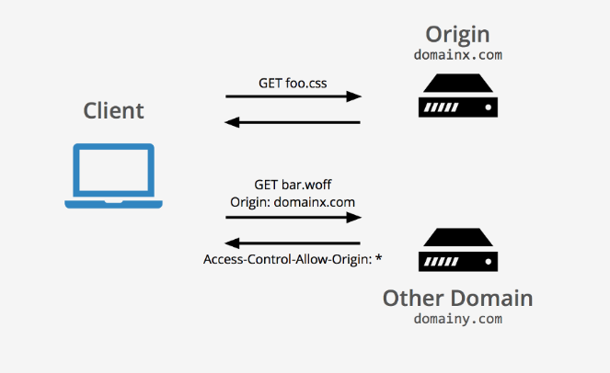
CORS
CORS - Representation

Slide 6
AJAX Techniques
CORS - Request Headers
When a domain is requesting to interact with a resource on another domain, request headers are added from the first domain in order to use the cross-origin resource sharing feature
Origin
Origin: <origin>
Access-Control-Request-Method
Access-Control-Request-Method: <method>
Access-Control-Request-Headers
Access-Control-Request-Headers: <field-name>[, <field-name>]*

Slide 7
AJAX Techniques
CORS – Response Headers
Access-Control-Allow-Origin
Access-Control-Allow-Origin: <origin> | *
Access-Control-Allow-Credentials
Access-Control-Allow-Credentials: true
Access-Control-Expose-Headers
Access-Control-Expose-Headers: <header-name>[, <header-name>]*
Access-Control-Max-Age
Access-Control-Max-Age: <delta-seconds>
Access-Control-Allow-Methods
Access-Control-Allow-Methods: <method>[, <method>]*
Access-Control-Allow-Headers
Access-Control-Allow-Headers: <header-name>[, <header-name>]*

Slide 8
AJAX Techniques
CORS – Two scenarios
Two scenarios of cross site access
Simple Requests
Preflighted Requests

Slide 9
AJAX Techniques
CORS – Simple Request
One of the allowed methods: GET, HEAD, POST
Apart from the headers automatically set by the user agent which are
Accept, Accept-Language, Content-Language, Content-Type, Viewport-Width, Width
The only allowed values for the Content-Type header are application/x-www-form-urlencoded, multipart/form-data, text/plain

Slide 10
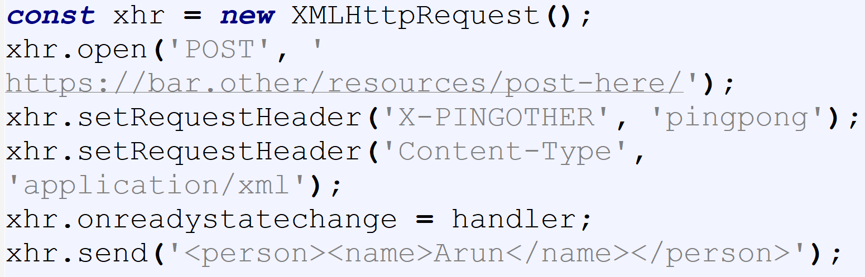
AJAX Techniques
CORS – Preflighted Request
Any other constraints meant for simple requests goes as preflighted requests.
It is a two step process
Example
Courtesy: Mozilla Developer

Slide 11
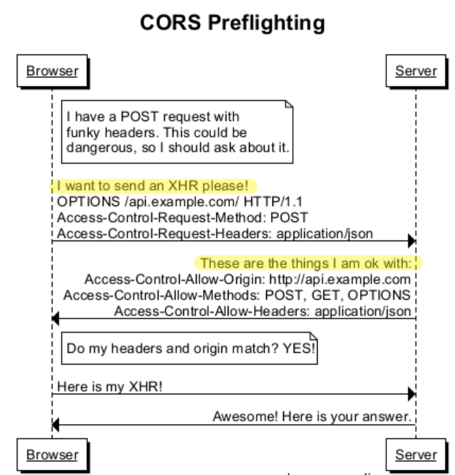
AJAX Techniques
CORS – Preflighted Request - Steps

Slide 12
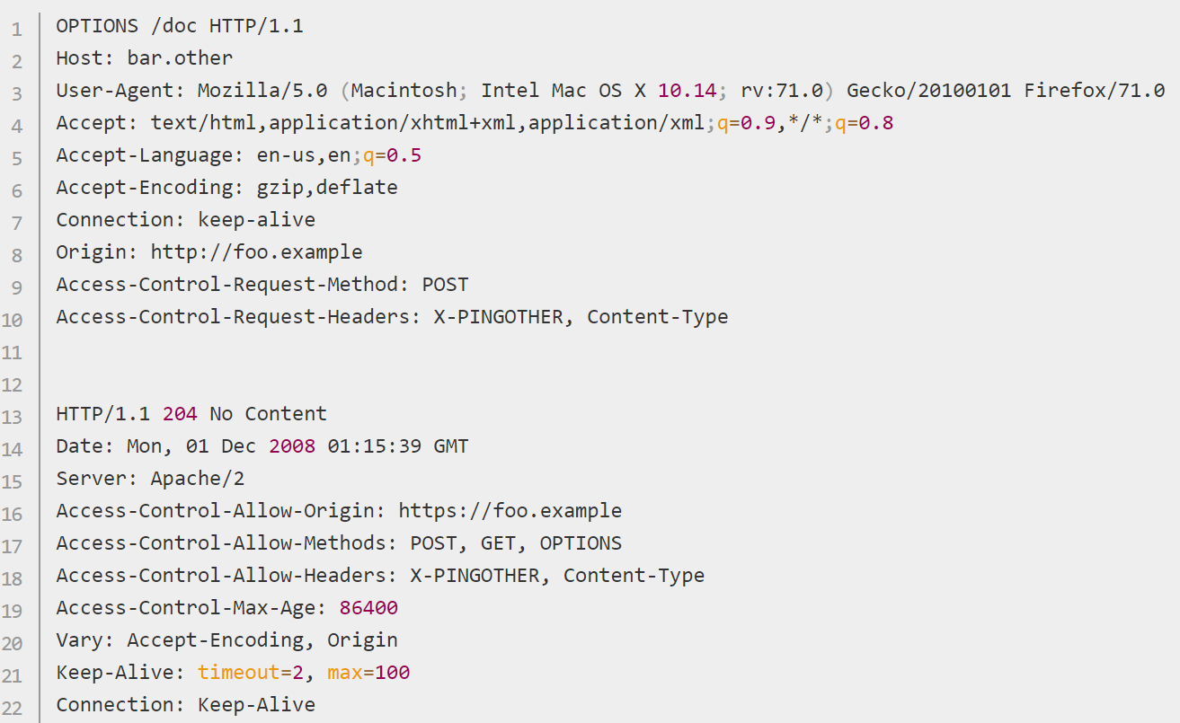
AJAX Techniques
CORS – Preflighted Request – Step 1

Slide 13
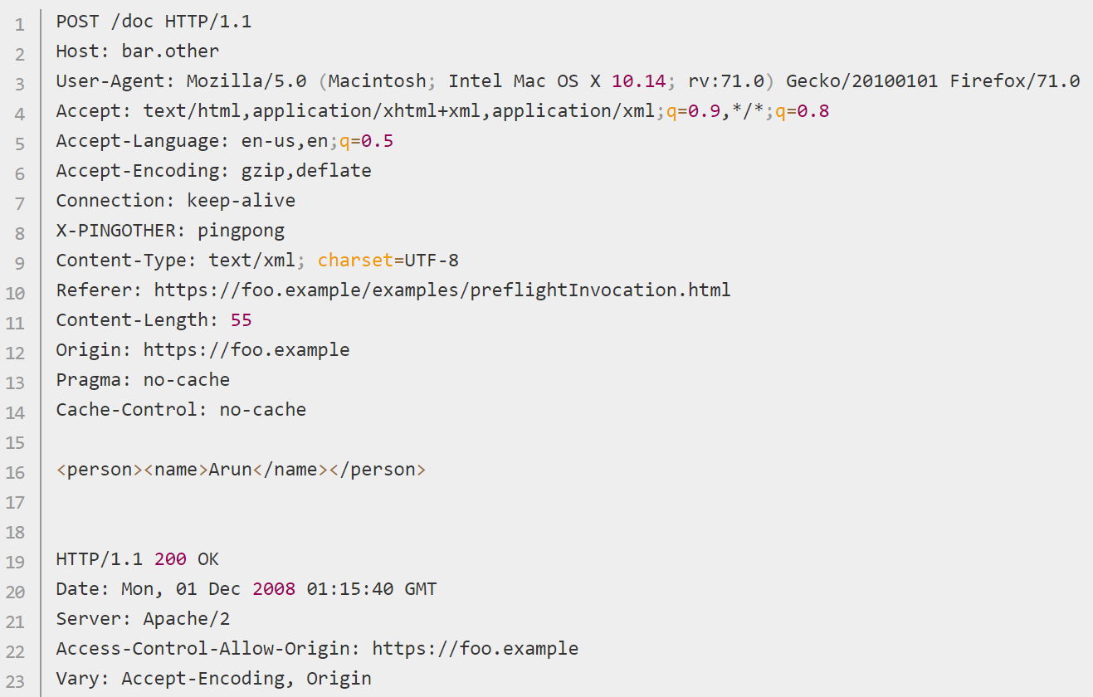
AJAX Techniques
CORS – Preflighted Request – Step 2

Slide 14
THANK YOU
Aruna S
Department of
Computer Science and Engineering
arunas@pes.edu

